Slide 1

Quantum Transpiler and Transpiler Optimization Methods

Slide 2
Agenda:
1. Quantum computing fundamentals
2. Introduction to Transpilation
2.1. Modeling hardware constraints
3. Introduction to Qiskit Preset Pass Manager
3.1. Init stage
3.2. Layout stage
3.3. Routing stage
3.4. Translation stage
3.5. Optimization stage
3.6. Scheduling stage

Slide 3

1
Quantum computing fundamentals

Slide 4
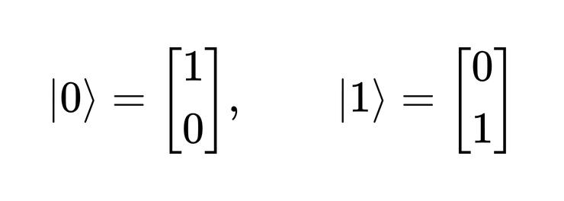
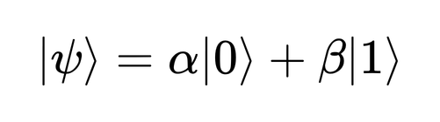

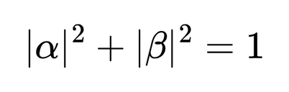
Bit and Qubit
- Classical bit can only be in one of two states: 0 or 1
- Qubit (quantum bit) has two basic states:
and it can be a combination of both basis states
where,
→ Superposition

Slide 5


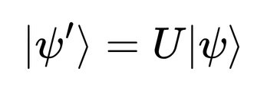
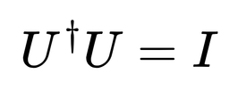
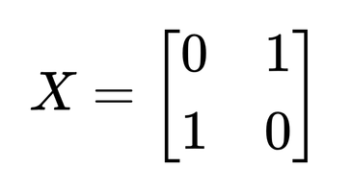
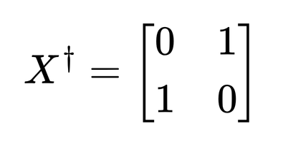
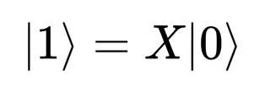
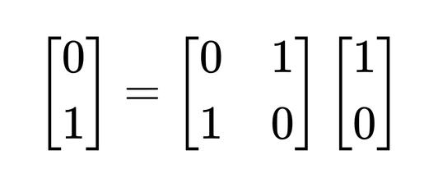
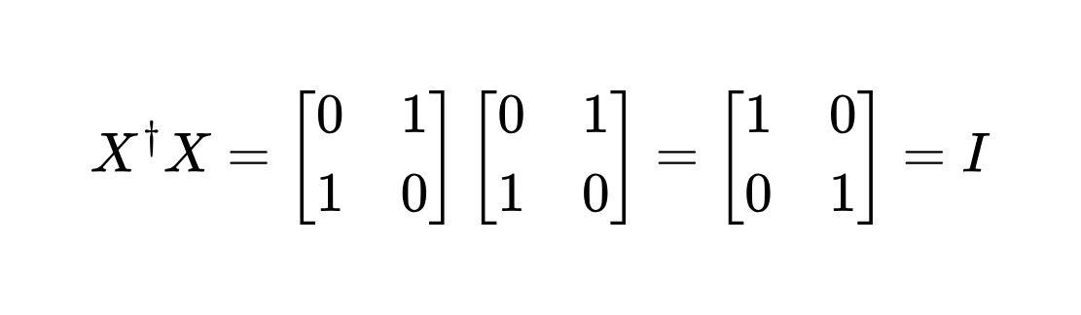
What is a Quantum Gate?
- A quantum gate is an operation that changes the state of one or more qubits
- If a qubit is in state
after applying a quantum gate , the new state:
and quantum gates are represented mathematically by unitary:
1) Quantum state example: 2) Unitary matrix example:

Slide 6
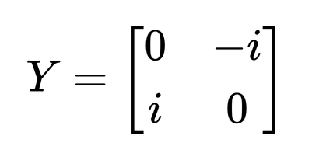
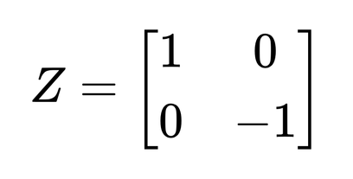
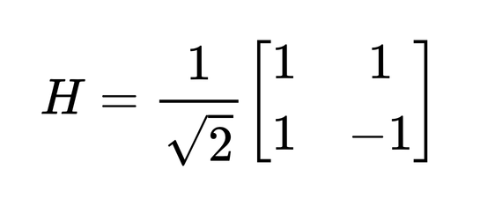
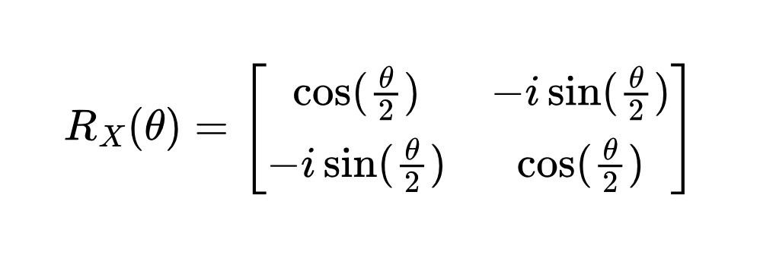
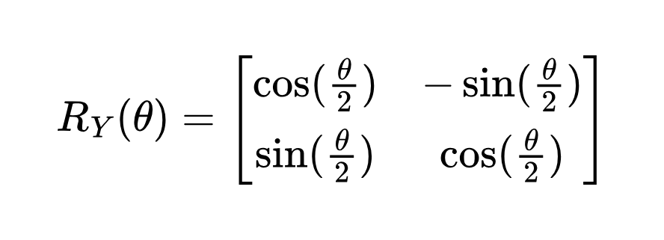
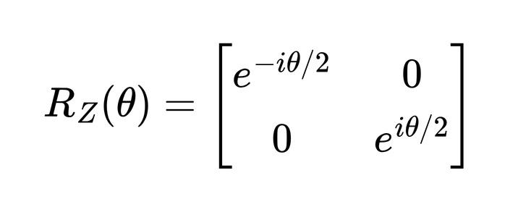
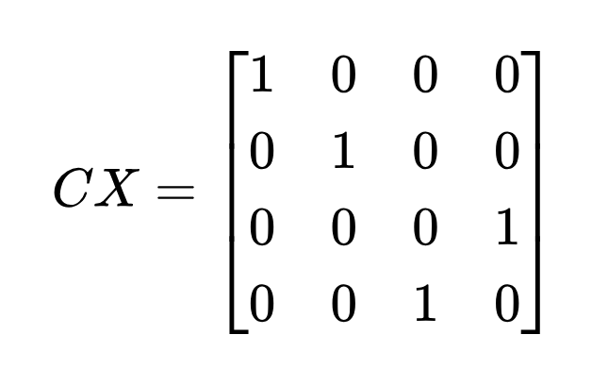
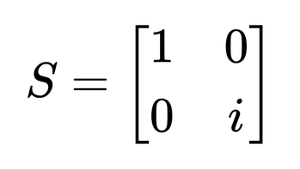
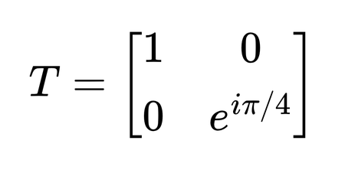
Quantum Gate
Pauli gates (1-qubit):
Hadamard H (1-qubit):
Rotation gates (1-qubit):
CX - CNOT (2-qubit):
Phase gates (1-qubit):

Slide 7
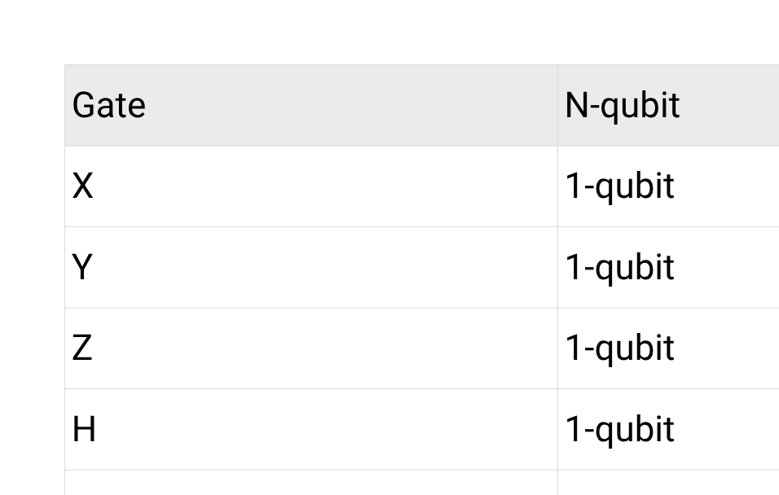
Quantum Gate

Slide 8
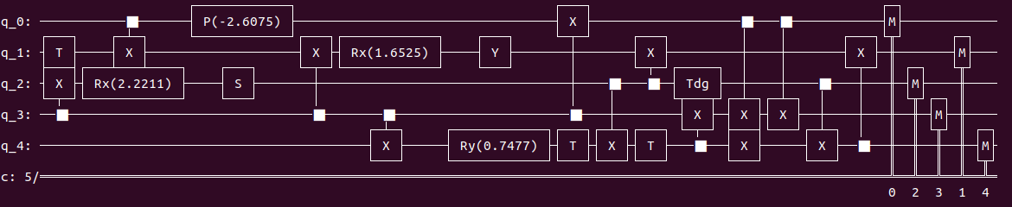
What is a quantum circuit?
- A quantum circuit is a graphical way to represent a sequence of quantum gates and measurements used to perform a quantum computation

Slide 9

2
Introduction to Transpilation

Slide 10
Why do we need quantum circuit compilation?
- Despite programming at a low level there are still abstraction in
our representation that can’t be excuted by hardware
- There are numerous hardware constraints that need to be
accounted for
- The compilation’s job is to take the high-level abstract circuit and
output an optimized circuit that can run on a given quantum computer

Slide 11

2.1
Modeling hardware
constraints

Slide 12

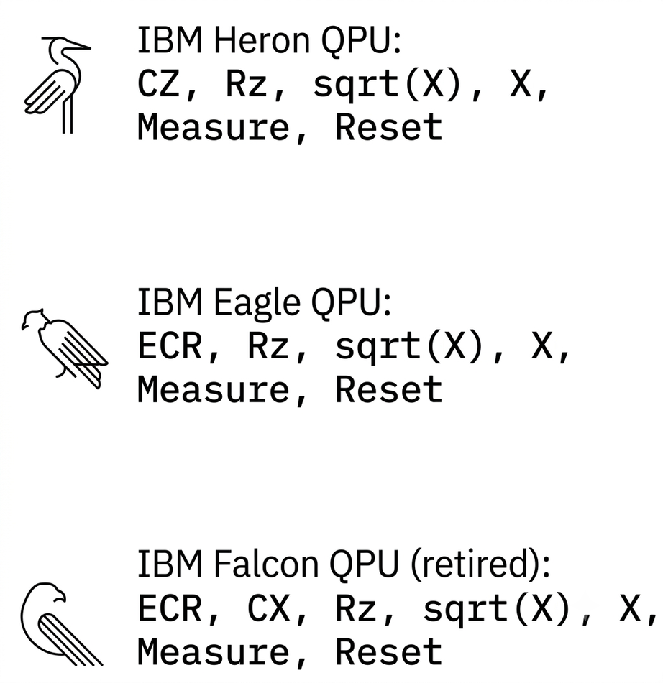
Operations
- Each quantum computer only supports a set
of operations
- Typically, hardware supports a universal gate
set that can be used to contruct any unitary
operation
- All qubits do not nesscesarily need to
support the same operations

Slide 13
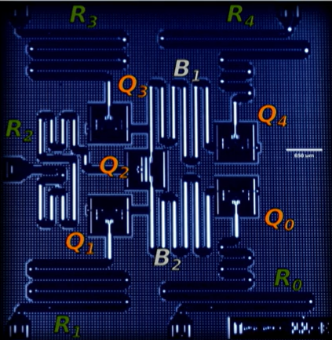
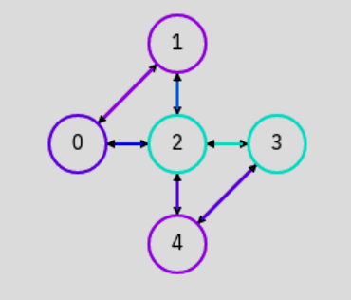
Qubit connectivity
- Qubit may have limited connectivity
IBM Yorktown 5-qubit
- For multi-qubit gates this means we can only
run these operations where there is
connectivity between qubits

Slide 14
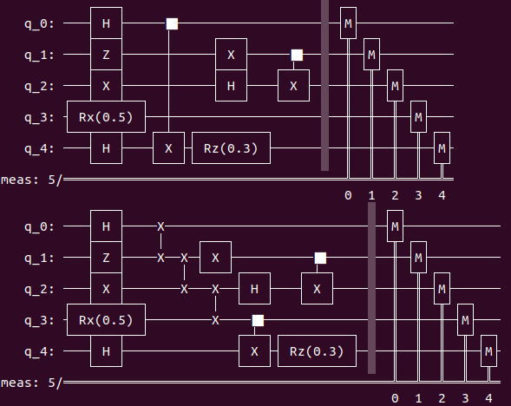
Connectivity contraints
- Connectivity is not always sufficient to fully map the abstract circuit
- The compiler will use SWAP gate (or other techniques) to move state between qubits
- So expensive to do → minimum SWAP gates as much as possible

Slide 15
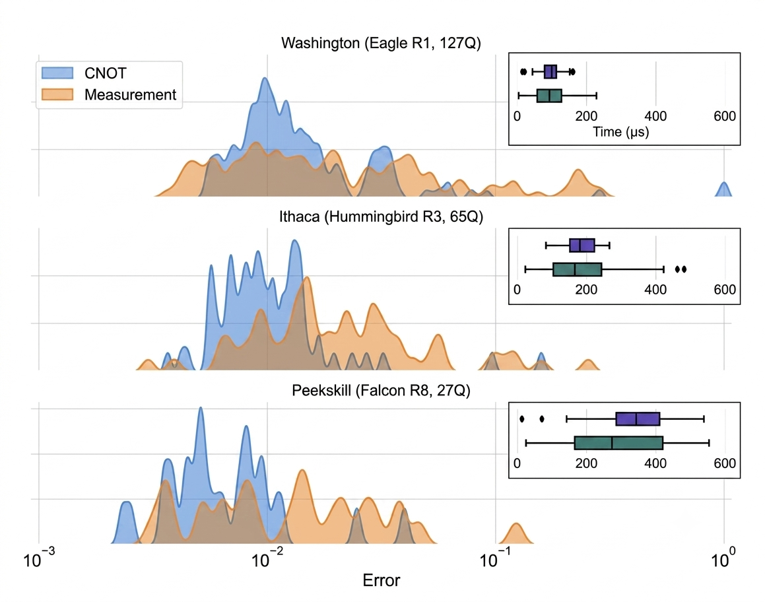
Noise
- Every operation is a potential source of noise or errors
- Gate errors:
  Single-qubit errors
  Multi-qubit errors
- Decoherence
  T1: Energy Relaxation, the time for a qubit at |1⟩ to decay to ground state |0⟩
  T2: dephasing of a qubit in superposition state
- Readout error
Variation of error rates and operation times across quantum hardware

Slide 16
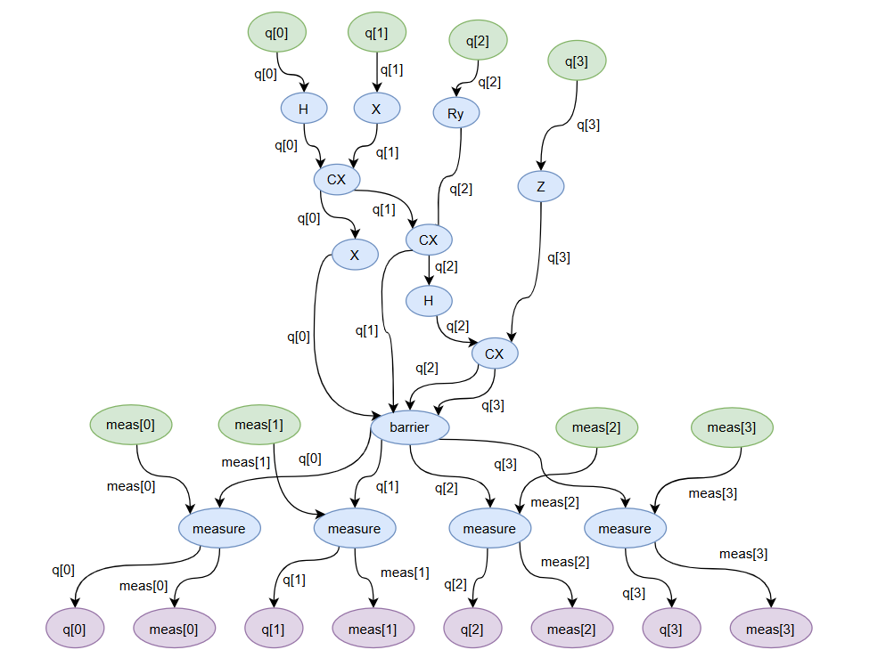
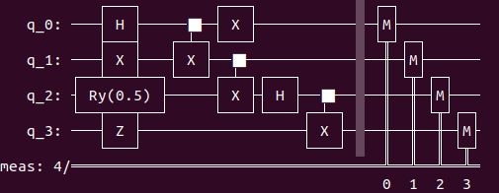
DAG Representation
- The DAGCircuit tracks the flow of data from input nodes through operations to output nodes
- The edges track bits (quantum/classical) and other classical variables

Slide 17

3
Introduction to Qiskit Preset Pass Manager

Slide 18
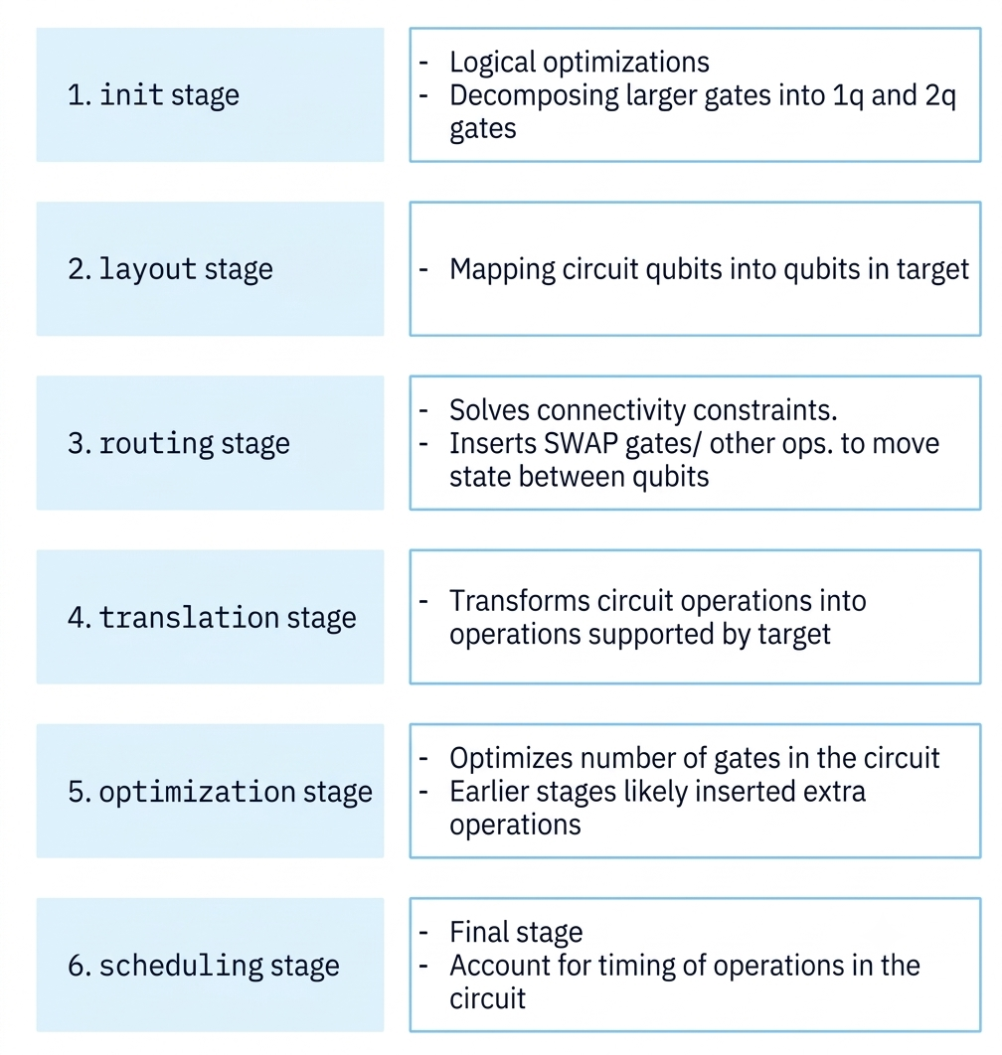
Pass Manager Stages
- The Qiskit compilation pipeline is devided into discrete stages
- Qiskit’s Preset Pass Manager uses 6 stages
- If you’re constructing a pass managers manually, you can define your own stages

Slide 19
3.1
init stage

Slide 20
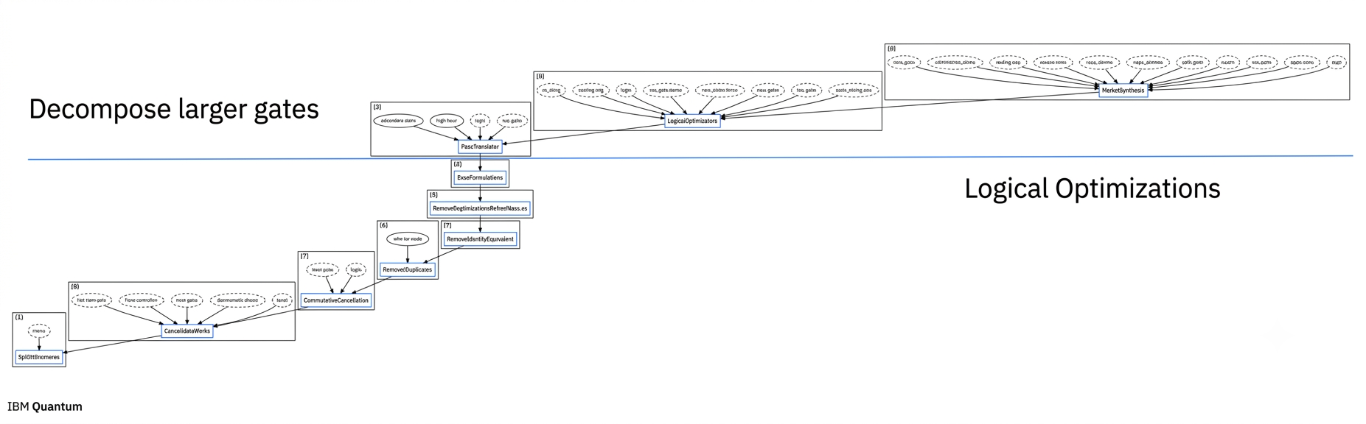
Init stage
- This stage is divided into two phases:
  Decompose larger (>= 3-qubit) gates to 1 and 2-qubit gates
  Logical optimizations

Slide 21
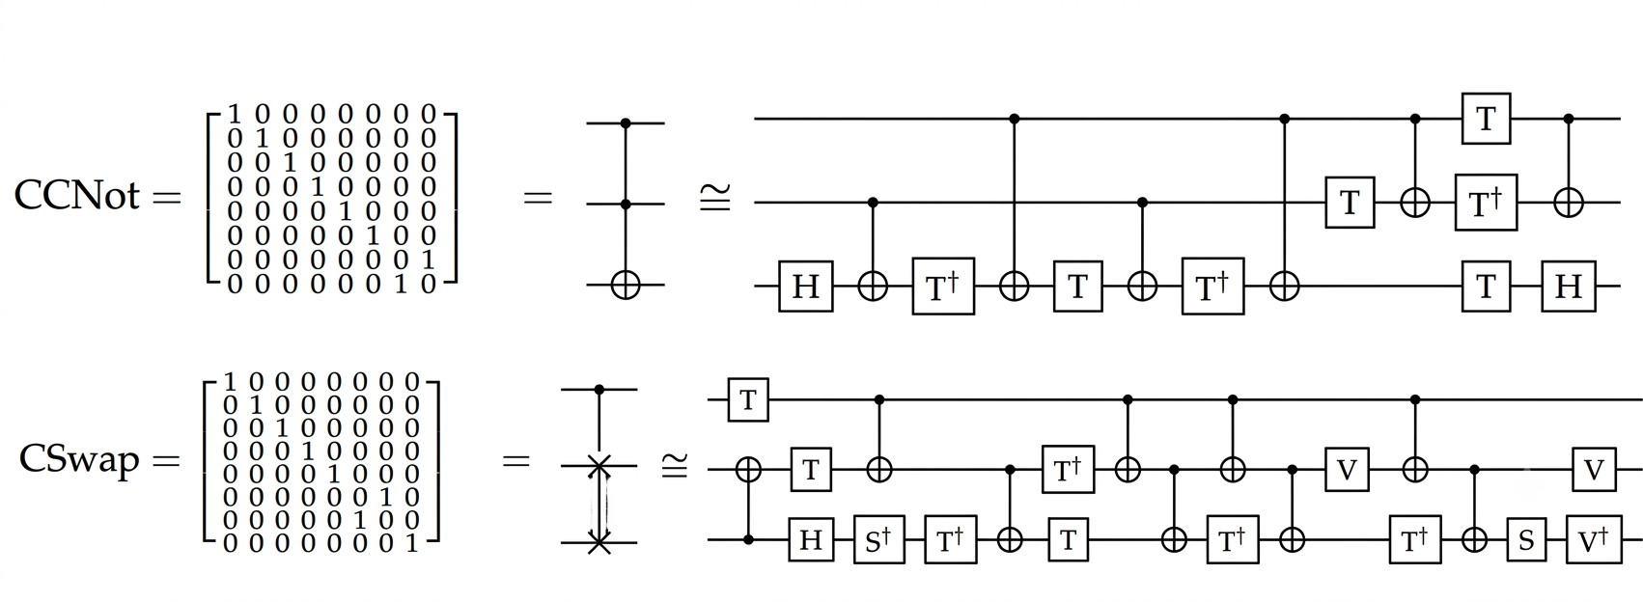
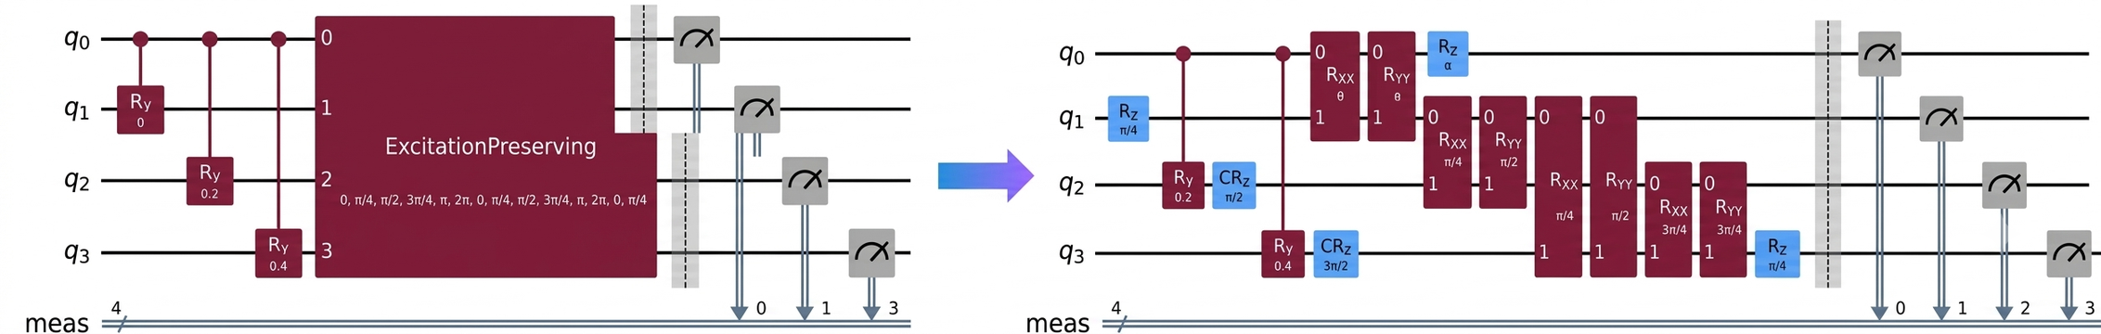
Decompose larger gates

Slide 22
Logical Optimization Passes
- RemoveIdentityEquivalent: Remove gates that are equivalent to an identity
- RemoveDiagonalBeforeMeasure: Remove a diagonal gate, that occurs immediately before
a measure. This doesn’t impact the the result of the measurement and can be removed
- InverseCannellation: Remove gates that are inverse pairs
- CommutativeInverseCannellation: Remove any inverse pairs found by reordering
commutative operations
- ConsolidateBlock: Consolidate blocks of 2-qubit gates into UnitaryGate
- Split2QUnitaries: Any UnitaryGates that are composed of a tensor product of two single-qubit gates will be decomposed into a single qubit UnitaryGate on each qubit

Slide 23
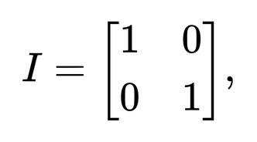
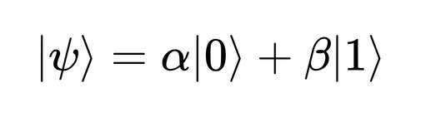
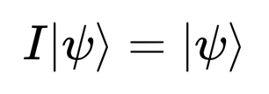
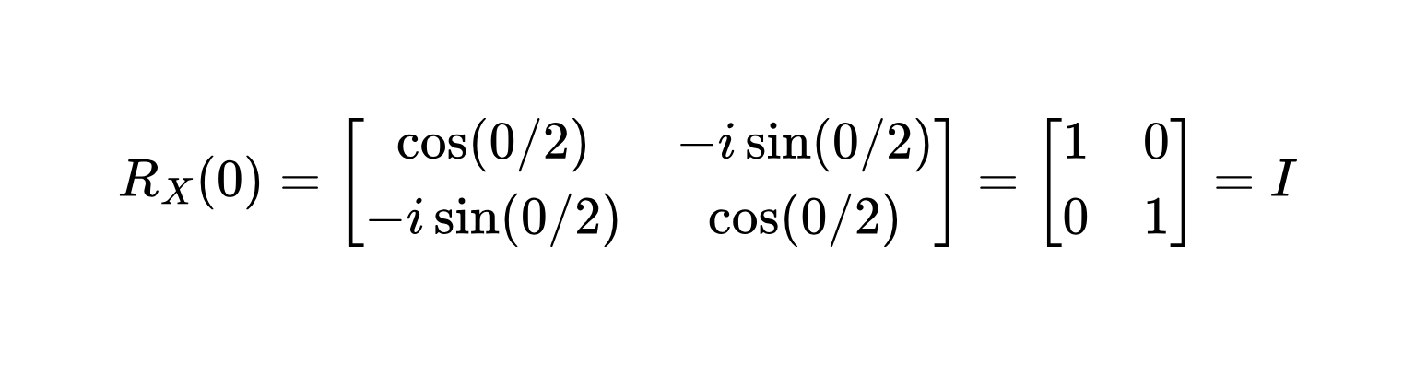
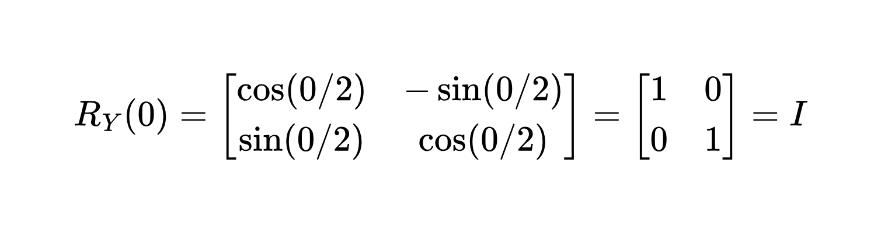
RemoveIdentityEquivalent Pass
- Remove I gates and gates equivalent to the identity gate because they do not change
the initial quantum state after being applied.
- Identity gate I
and init state
then state after I gate
- I gate equivalent:

Slide 24
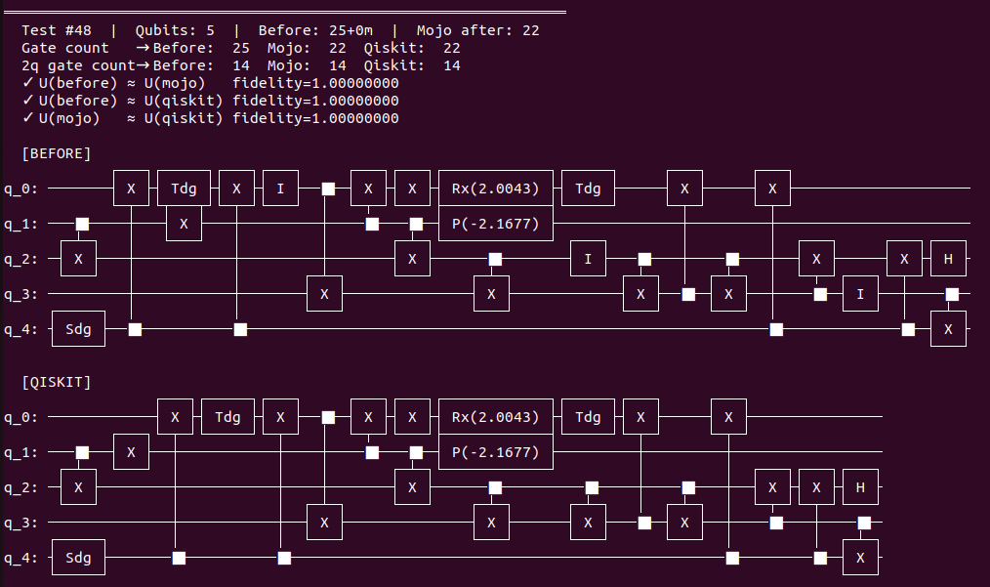

RemoveIdentityEquivalent Pass

Slide 25
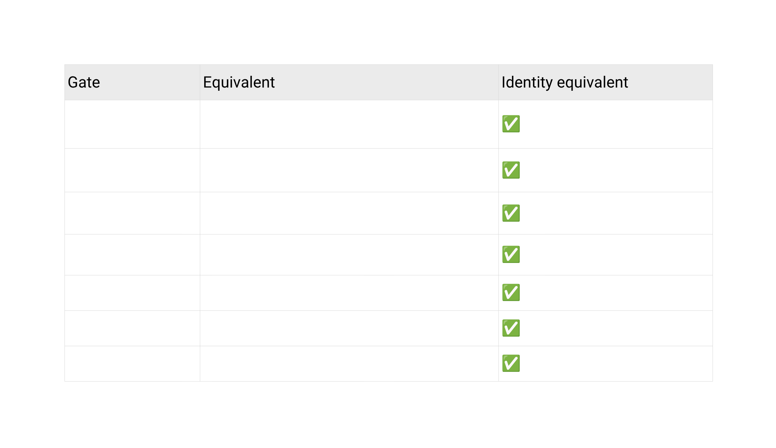
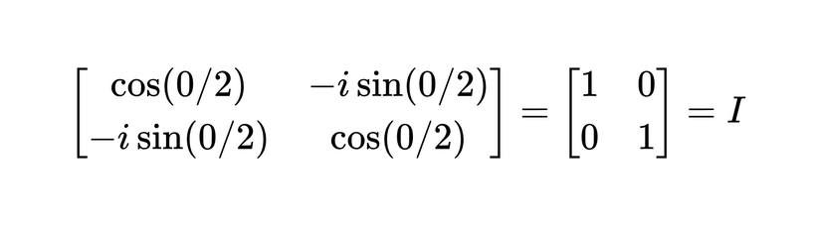

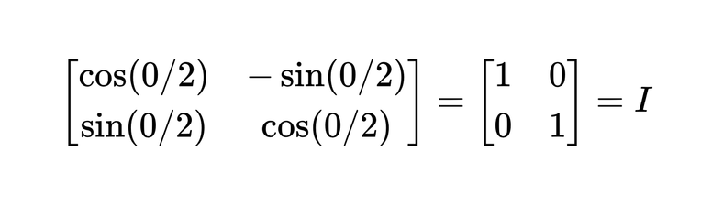

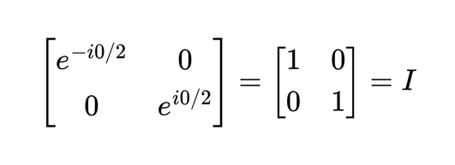

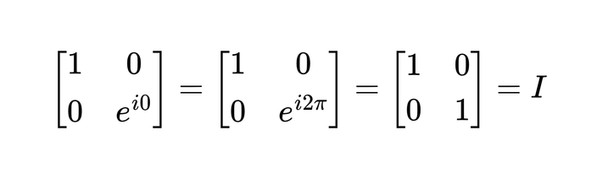
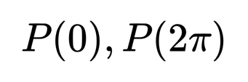
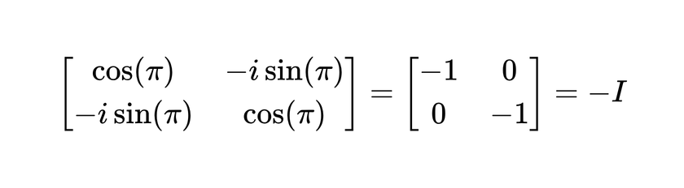

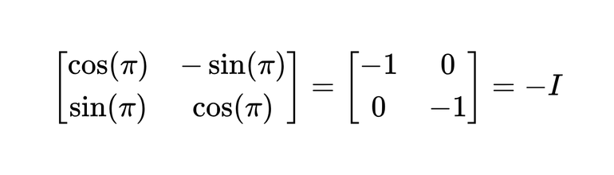

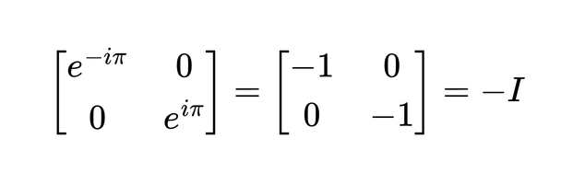

RemoveIdentityEquivalent Pass

Slide 26
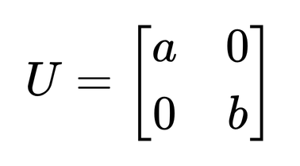
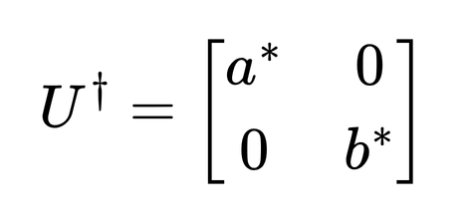
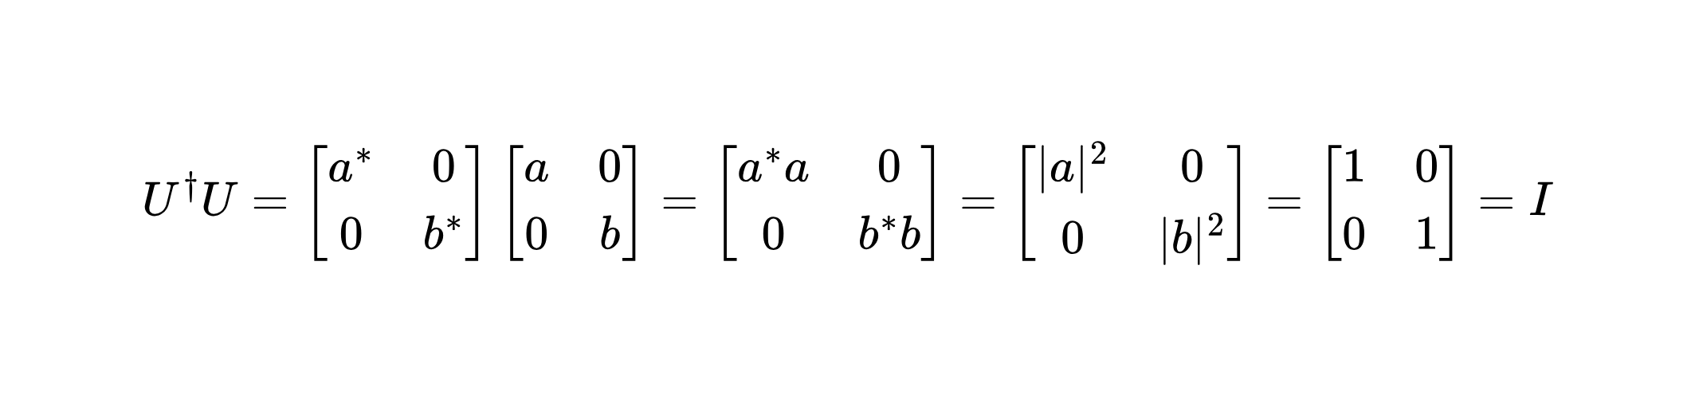






RemoveDiagonalBeforeMeasure Pass
- Remove a diagonal gate, that occurs immediately before a measure. This doesn’t
impact the the result of the measurement and can be removed
- A diagonal 1-qubit gate: , and it’s conjugate transpose:
and U is unitary gate , so
→
- A complex: , but
→ General diagonal quantum gate:

Slide 27





























RemoveDiagonalBeforeMeasure Pass

Slide 28

RemoveDiagonalBeforeMeasure Pass

Slide 29









InverseCannellation Pass
- Remove gates that are inverse pairs. With quantum gate , inverse :
quantum gate is unitary:
→
Example:
, and inverse of S:
and
so we can remove these gates of quantum circuit

Slide 30







InverseCannellation Pass

Slide 31

InverseCannellation Pass

Slide 32





CommutativeInverseCannellation Pass
- Remove inverse gate pairs that are separated by operations that commute with them.
- A and B commute if:
or
A and B commute so we can:

Slide 33







Example 1: COMMUTE - Two gates on different qubit
- X gate on qubit 0, Z gate on qubit 1
then
and
so

Slide 34














Example 2: UNCOMMUTE - Pauli gates on the same qubit
- Pauli X, Y, Z
- X, Y, and Z do not commute pairwise when acting on the same qubit:
→
→
→

Slide 35








Example 3: COMMUTE - Diagonal gates on the same qubit
- Diagonal gate:
then
so

Slide 36









Example 4: COMMUTE - Diagonal gate on control qubit of CX
- CX gate:
- Diagonal gate:
- Diagonal gate on control qubit:
and

Slide 37







Example 5: COMMUTE - X-axis gate on target qubit of CX
- CX gate:
- X gate:
- X gate on target qubit:
and

Slide 38










Example 6: Two CX gates
- Two CX gates same control:
- Two CX gates same target:

Slide 39

CommutativeInverseCannellation Pass

Slide 40



ConsolidateBlock Pass
- Combine a sequence of quantum gates into a unitary block operation
- The unitary before and after must have fidelity is 1

Slide 41




Why do we need ConsolidateBlocks
- A quantum circuit may contain a long sequence of gates, each gate corresponds a
unitary matrix:
- The entire gate sequence is
equivalent to a single unitary:
therefore, instead of treating
each gate separately:
we can consolidate them and
decomposed into a more
efficient gate sequence.

Slide 42

ConsolidateBlock Pass

Slide 43



Split2QUnitaries
- Decompose a general two-qubit unitary into single-qubit operations and entangling
operations.

Slide 44

Why do we need Split2QUnitaries?
1. Arbitrary U(4) is not directly executable
2. Decompose a unitary into the hardware's basis gate set
3. Optimize the circuit by consolidating gate blocks and decomposing them into fewer gates

Slide 45






Euler Decomposition
- An arbitrary single-qubit is described by a unitary matrix:
and it can be expressed as three rotations about two axes.
YZY Euler decomposition:
because global phase does not affect measurement probabilities so, we can ignore global phase and decompose G
while

Slide 46
















Euler decomposition step-by-step
1. First, we have a arbitrary single-qubit unitary: and gate
2. Compute
3. Diagonalize , then find and . And must be of the form
4. We now have and we may find
5. Decomposition has form by compute .
6. Finally, we extract the angles :
[1] Euler Angle decomposition, “Constructive Quantum Shannon Decomposition from Cartan Involutions”, Byron Drury et al, arXiv: 0806.4015

Slide 47




Example: Euler decomposition
We have: and
Step 1: Compute square of M
→

Slide 48




Example: Euler decomposition
Step 2: Diagonalization by finding the eigenvalues
We have:
and
so the eigenvalues are:
Diagonal matrix:

Slide 49




Example: Euler decomposition
Step 2: Diagonalization by finding the eigenvalues
For each eigenvalue, we find the corresponding eigenvector by:
so we have two eigenvectors:
finally, we have eigenvector matrix:

Slide 50



Example: Euler decomposition
Step 3: Take Square Root
Compute:
and we find:
Finally, from (1), (2) and (3), we have:

Slide 51



Cartan/KAK Decomposition
- This method is used to decompose an arbitrary two-qubit gate
into 3 part:
where

Slide 52











Cartan/KAK Decomposition
1. First, we define a “magic basis” of Bell states:
2. Define a new operator
3. Compute
4. Diagonalize and find diagonal matrix and
5. Find and
6. We have and and
7. Finally, we extract from
[1] “Constructive Quantum Shannon Decomposition from Cartan Involutions”, Byron Drury et al, arXiv: 0806.4015
[2] “Optimal Quantum Circuits for General Two-Qubit Gates”, Farrokh Vatan and Colin Williams, arXiv: 0308006v3

Slide 53




Cartan/KAK Decomposition
After that, we have:
1. First exponential of the entanglement:
2. Second exponential of the entanglement:
3. Last exponential of the entanglement:
According to Vatan and Williams, an arbitrary two-qubit unitary can be decomposed using at most 15 single-qubit gates and 3 CX gates

Slide 54
3.2
layout stage

Slide 55

Layout stage
- This stage takes the virtual qubits from abstract circuit and maps them to a qubit as
define as defined in the target
- Layout is of critical importance because not all qubits perform the same
- This stage typically tries multiple techniques to find the best layout
- A poor layout can induce more SWAPs because of the connectivity

Slide 56

VF2Layout
- Builds a graph from 2-qubit interactions
in the circuit
- Searches for isomorphic subgraphs in the
target’s connectivity graph
- If a subgraph is found, a layout without
swaps can be used
- After a layout is found, it searches for
additional layouts

Slide 57





VF2 Algorithm
“VF2++—An improved subgraph isomorphism algorithm”,Alpár Jüttner et al, Discrete Applied Mathematics
1. The candidate set

Slide 58


VF2 Algorithm
“VF2++—An improved subgraph isomorphism algorithm”,Alpár Jüttner et al, Discrete Applied Mathematics
2. Consistency
The adjacency relationship between logical nodes must be preserved in the corresponding physical nodes

Slide 59



VF2 Algorithm
“VF2++—An improved subgraph isomorphism algorithm”,Alpár Jüttner et al, Discrete Applied Mathematics
3. Cutting rules
Prune the branch if the current mapping cannot be extended to a complete mapping

Slide 60


Example: Find layout using VF2Layout

Slide 61

Example: Find layout using VF2Layout

Slide 62

Example: Find layout using VF2Layout

Slide 63

Example: Find layout using VF2Layout

Slide 64

Example: Find layout using VF2Layout

Slide 65

Example: Find layout using VF2Layout

Slide 66

Example: Find layout using VF2Layout

Slide 67

Example: Find layout using VF2Layout

Slide 68

Example: Find layout using VF2Layout

Slide 69

Example: Find layout using VF2Layout

Slide 70
SabreLayout Pass
- Run if VF2Layout doesn’t find a layout
- Based on SABRE (Swap-based BidiREctional) algorithms:
  Starts with an initial random guess
  Routers circuit by swapping qubits in the layout instead of inserting swap gates
  If fully routed, reverses edge direction in the DAG and re-routes
  Repeats multiple times to minimize swap count

Slide 71


Sabre algorithm
Input 1: Front Layer F
[1] SWAP-based Heuristic Search Algorithm, “Tackling the Qubit Mapping Problem for NISQ-Era Quantum Devices”, Gushu et al, arXiv: 1809.02573

Slide 72


Sabre algorithm
Input 2: Coupling graph
Input 3: Distance matrix
[1] SWAP-based Heuristic Search Algorithm, “Tackling the Qubit Mapping Problem for NISQ-Era Quantum Devices”, Gushu et al, arXiv: 1809.02573

Slide 73


Sabre algorithm
Input 4: DAG circuit
Input 5: Init mapping
[1] SWAP-based Heuristic Search Algorithm, “Tackling the Qubit Mapping Problem for NISQ-Era Quantum Devices”, Gushu et al, arXiv: 1809.02573

Slide 74

Sabre algorithm

Slide 75


Sabre algorithm

Slide 76

Sabre algorithm

Slide 77

Sabre algorithm

Slide 78









Sabre algorithm
The SABRE Heuristic Cost Function:
[1] “Tackling the Qubit Mapping Problem for NISQ-Era Quantum Devices”, Gushu et al, arXiv: 1809.02573
[2] “LightSABRE: A Lightweight and Enhanced SABRE Algorithm”, Henry Zou et al, arXiv: 2409.08368v1
Try s1 = SWAP(Q0, Q1) and we have temp mapping:
Before:
After:
Front layer:
Extended set:

Slide 79


Sabre algorithm
Compare all candidates:
Best SWAP:

Slide 80

Sabre algorithm

Slide 81

Sabre algorithm

Slide 82

Sabre algorithm

Slide 83

Sabre algorithm

Slide 84

Sabre algorithm

Slide 85

Sabre algorithm

Slide 86

Sabre algorithm

Slide 87

Sabre algorithm

Slide 88

Sabre algorithm

Slide 89

Sabre algorithm

Slide 90


Sabre algorithm

Slide 91

Sabre algorithm

Slide 92

Sabre algorithm

Slide 93

Sabre algorithm

Slide 94

Sabre algorithm

Slide 95

Sabre algorithm

Slide 96

Sabre algorithm

Slide 97

Sabre algorithm

Slide 98

Sabre algorithm

Slide 99

Sabre algorithm

Slide 100

Sabre algorithm

Slide 101

Sabre algorithm

Slide 102


Sabre algorithm

Slide 103

Sabre algorithm

Slide 104

Sabre algorithm

Slide 105

Sabre algorithm

Slide 106
3.3
routing stage

Slide 107

Routing stage
- This stage takes the circuit with a layout set and inserts SWAP gates where necessary
- If running with default however this pass is skipped for efficiency, and it’s run as part of
SabreLayout in the Layout stage
- We re-run layout with VF2PostLayout after SWAP insertion to search for a better layout

Slide 108
VF2PostLayout Pass
- Just like VF2Layout:
  Build a graph from 2-qubit interactions in the circuit
  Searches for isomorphic subgraphs in the target’s connectivity graph
- Different with VF2Layout: the pass is run post-routing, this
guarantees at least one isomorphic subgraph
- Again, the pass searches for additional layouts and picks the
layout with the lowest error rate

Slide 109
3.4
translation stage

Slide 110

Translation stage
- This stage is responsible for making sure that all the operations are supported on the
target
- It takes the routed circuit, which already meets the target connectivity constraints
- It run the same passes as the first phase of the init stage, but for all operations instead of
just those with >= 3-qubit

Slide 111
HighLevelSynthesis Pass
UnitarySynthesis Pass
- Pluggable synthesis of high level objects
- Specialized pass for synthesizing
UnitaryGates in the circuit
- Scans the DAG for gates outside the
target that have an installed plugin available
- Has a plugin interface to enable
configurable synthesis, each plugin is
giving the unitary matrix and synthesizes
it to an equivalent circuit
- Plugins can be written for any object
- Calls the plugin to synthesis the high level
abstract object into an equivalent circuit
- Qiskit has 3 built-in plugins for unitary
systhesis

Slide 112

Basis Translator
- The basis translator uses an equivalence library that builds a graph of equivalent
circuits to a gate
- Dijkstra’s algorithm is used to find a path from a given gate to gates in the target
- The gates in the circuits are recursively along the path to build an equivalent circuit
that conforms to the target
- Each gate is then replaced in the DAG by that equivalent circuit

Slide 113

Basis Translator

Slide 114
3.5
optimization stage

Slide 115

Optimization stage
- This stage takes the mapped circuit and optimizes it to reduce unnecessary operations
- It runs in a loop until a fixed point in depth and size is found between subsequent iterations

Slide 116

Optimization stage

Slide 117

Optimization stage
1-qubit Unitary Peephole Optimization
- Optimize1qGatesDecomposition finds sequences of single qubit gates and optimizes
them

Slide 118

Optimization stage
1-qubit Unitary Peephole Optimization
- Optimize1qGatesDecomposition finds sequences of single qubit gates and optimizes
them

Slide 119


Optimization stage
2-qubit Block Collection
- Collect2qBlocks traverses the DAG efficiently
- For each CNOT, it collect ancestors and predecessors
until a branch is found
- These form a 2q block

Slide 120

Optimization stage
2-qubit Unitary Peephole Optimization

Slide 121

Optimization stage
Commutative Cancellation

Slide 122
3.6
SCHEDULING stage

Slide 123

Scheduling stage
- This stage takes the mapped and optimized circuit
- It analyzes the runtime of the operations in the circuit and identifies idle periods on each
qubit
- It will then insert explicit operations to account for all the time in the circuit

Slide 124

Scheduling stage
- This stage takes the mapped and optimized circuit
- It analyzes the runtime of the operations in the circuit and identifies idle periods on each
qubit
- It will then insert explicit operations to account for all the time in the circuit

Slide 125
Thank you

